Slide 1
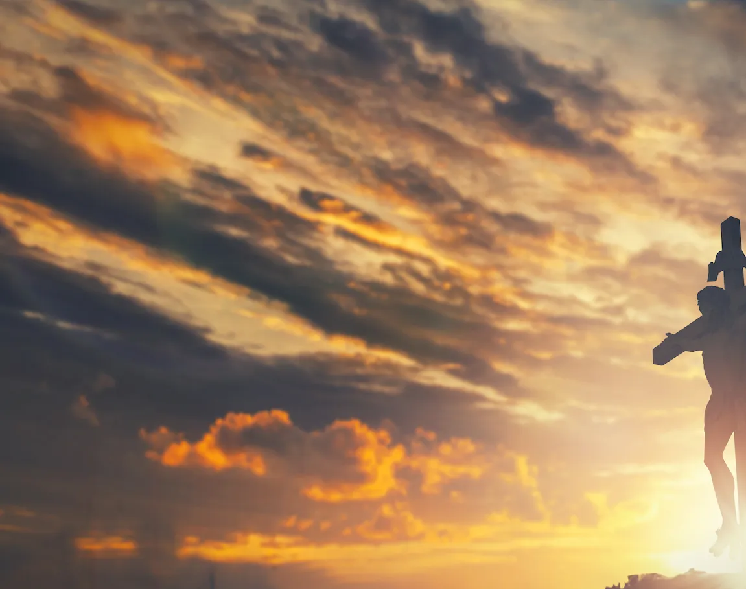
Turn Your Eyes Upon Jesus

Slide 2
G / Bm / C / D
G Bm
O soul are you weary and troubled
C G
No light in the darkness you see
G Bm
There's light for a look at the Savior
C D G
And life more abundant and free

Slide 3
G D Em D
Turn your eyes upon Jesus
C Em D
Look full in His wonderful face
G Bm
And the things of earth
Em G
Will grow strangely dim
G D G
In the light of His glory and grace

Slide 4
G Bm
Through death into life everlasting
C G
He passed and we follow Him there
G Bm
O’er us sin no more hath dominion
C G
For more than conquerors we are

Slide 5
G D Em D
Turn your eyes upon Jesus
C Em D
Look full in His wonderful face
G Bm
And the things of earth
Em G
Will grow strangely dim
G D G
In the light of His glory and grace

